Slide 1
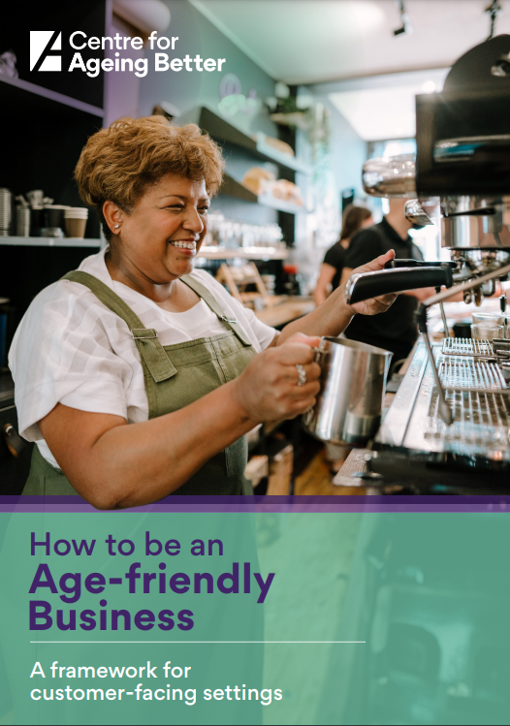
How to be an Age-friendly Business A framework for customer-facing settings ageing-better.org.uk/age-friendly-businesses
Notes:
Purpose of the slides: These presentation slides have been developed as a way for Age-friendly Communities, local authorities and other key stakeholders to introduce the framework to their audiences. Giving a brief overview and insight into the content of the framework in the hope that people will then go away and access a copy.
Audiences: Examples of the audiences to present the framework to may include existing partners in your area, business owners or managers, community development workers, business improvement districts.
How we want people to use them: The slides have been set up as a quick whistle stop tour of the framework, with text in the notes section that can be used as a script or reference for talking through each slide.
Time for presentation: Approximately 8-10 minutes.
Script:
The Centre for Ageing Better have produced a resource called ‘How to be an Age-friendly Business: A framework for customer-facing settings’. It is aimed at all customer-facing businesses and settings that might want to identify how they can be more age-friendly.
*by customer-facing settings we mean the sorts of places that people engage with in their day-to-day lives such as shops, cafes, leisure centres, hairdressers, cinemas, museums etc.

Slide 2
Why should businesses be age-friendly?
Being age-friendly is good for business, good for people of all ages and good for our wider society.
It’s good for business
‘By 2040, it’s predicted that 63p in every pound spent by consumers in the UK will be spent by someone aged 50 or over: it’s estimated that total spending by this group will be worth £550 billion.’
It’s good for wider society
Supporting people to stay in work, contribute to their communities for longer, and spend their money locally.
To comply with the law
Business and public sector organisations have a legal duty under the Equality Act 2010 and Public Sector Equality Duty.
Notes:
But why should businesses even think about being age-friendly? There are three main reasons:
Firstly – it’s good for businesses – both in terms of the spending power of the older population (as this quote shows), but also because many age-friendly practices are also good business practices that are likely to appeal to a broad range of potential customers including people with young families or disabilities for example (giving greater access to the purple pound).
Secondly – it’s good for wider society. By that we mean…By making it easier for people of all ages and abilities to use and engage with your business, more people – whether as customers, staff or volunteers – are able to stay in work and contribute to their communities for longer, and to spend their money locally. In turn, this can support local economies, enable independent living, reduce social isolation, improve mental and physical health, and increase wellbeing.
Thirdly – it is now unlawful to discriminate based on age. Businesses and public sector organisations have a legal duty under the Equality Act 2010 and the Public Sector Equality Duty to identify and consider the impact and potential impact of their activities in terms of equality. Although it is worth noting - there are some exceptions set out in the Equality Act 2010.
Quote source: Money well spent – Overcoming barriers to spending in later life, International Longevity Centre UK, June 2023
Available at: https://ilcuk.org.uk/money-well-spent-overcoming-barriers-to-spending-in-later-life
Links:
Equality Act 2010 https://www.legislation.gov.uk/ukpga/2010/15/contents
Public Sector Equality Duty https://www.gov.uk/government/publications/public-sector-equality-duty

Slide 3
The older consumer market
It has been estimated that the over 50’s hold approximately 70% of the UK wealth
UK Active
People in the 50-64 age bracket have the second highest average weekly household expenditure on clothing in the UK
Statista
People living in a typical 45 apartment retirement development generate £550,000 of spending per year, £347,000 of which is spent on the local high street. Some £225,000 of this is new spending in the local authority, directly contributing to keeping local shops open
The Housing Learning and Improvement Network
Notes:
This slide provides some information to help make the case to businesses in terms of the older consumer market. Edit in / out relevant statistics or quotes as you see fit for your particular purpose and audience.
Sources of information:
Money well spent – Overcoming barriers to spending in later life, International Longevity Centre UK, June 2023
https://ilcuk.org.uk/money-well-spent-overcoming-barriers-to-spending-in-later-life
By 2040, it’s predicted that 63p in every pound spent by consumers in the UK will be spent by someone aged 50 or over: it’s estimated that total spending by this group will be worth £550 billion.
Average weekly household expenditure on clothing in the United Kingdom (UK) in 2022, by age of household reference person https://www.statista.com/statistics/285588/clothing-weekly-household-expenditure-in-united-kingdom-uk-by-age/
– £16.4 compared to £18.2 for 30-49 year olds at the highest amount followed by £12 for 65-74 year olds as the third highest​People in the 50-64 age bracket have the second highest average weekly household expenditure on clothing in the UK in 2022
​
UK lifestyles of the over 65s: Market report (2022) https://store.mintel.com/report/uk-lifestyles-of-the-over-65s-market-report ​
Seniors in the UK are in a relatively strong financial position, with 41% in a healthy financial position, and a further 43% claiming to be getting by. 40% of over 65s say the COVID-19 outbreak has made them want to have more fun in life.​
UK Active: Life in our years (2021)​ https://www.ukactive.com/wp-content/uploads/2021/06/Life-in-our-Years.pdf ​
Given that it has been estimated that over 50’s hold approximately 70% of the wealth, understanding the needs of older adults combined with innovative approaches to provide appropriate services may present an area for commercial growth.’​
Saga News: ​“Generation Experience”: over-50s revealed as £600 billion economic superpower
https://newsroom.saga.co.uk/news/generation-experience-over-50s-revealed-as-gbp-600-billion-economic-superpower
People over 50 contribute a massive £602 billion to the UK economy every year
The Housing Learning and Improvement Network: Senior Saviours for the high street
https://www.housinglin.org.uk/Topics/type/Silver-Saviours-for-the-High-Street/
'People living in a typical 45 apartment retirement development generate £550,000 of spending per year, £347,000 of which is spent on the local high street. Some £225,000 of this is new spending in the local authority, directly contributing to keeping local shops open.'

Slide 4
Local population data
XXX has a population size of XXX​
In XXX the older population has grown by XX% over the last 10 years
Around XXX residents or XX% of the population are 65+ and XX% of the population are 50+ ​
Notes:
EDITABLE SLIDE: Use this slide to insert any local information / data that might be useful for encouraging people to adopt / use the framework. Some example text has been provided that you can edit. You could include population predictions here if data suggestions this is likely to be above the national average in your area for example.
You might also want to include:
Bonuses for businesses that the LA / AfC or other organisations might be offering e.g., promotional activity, window stickers, newsletters, networking events.
Any important information that you might want to share about local changes / redevelopments etc.
Insert your own script for this slide.
Useful links
ONS population data: https://www.ons.gov.uk/peoplepopulationandcommunity
ONS population projections: https://www.ons.gov.uk/peoplepopulationandcommunity/populationandmigration/populationprojections
Health and lifestyles survey: https://www.ons.gov.uk/surveys/informationforhouseholdsandindividuals/householdandindividualsurveys/healthandlifestylesurveyhls
Living costs and food survey: https://www.ons.gov.uk/peoplepopulationandcommunity/personalandhouseholdfinances/incomeandwealth/methodologies/livingcostsandfoodsurvey

Slide 5
Introducing the framework
The framework maps out five interconnected areas for businesses to consider if they want to be age-friendly:
It summarises easy steps all customer-facing businesses can take.
Your people
Your premises
Your communications
Your offer
Your place within the wider community
Notes:
The framework maps out the 5 key areas that businesses should consider if they want to be age-friendly. This are:
Your people
Your premises
Your communications
Your offer
Your place within the wide community.
It brings together evidence and insights from a wide range of source in the UK and further afield, summarising easy steps that can be taken to ensure that respect for and inclusion of older people is embedded in business practices.

Slide 6
How to use the framework
The framework can be used to…
help businesses identify and make simple changes
facilitate discussions with staff and volunteers
review and inform business policies or codes of practice
provide a basic structure to inform local schemes or incentives for businesses
inspire strategic conversations and planning between businesses and people working locally
It summarises easy steps all customer-facing businesses can take.
Notes:
The information provided in the framework aims to help people recognise what is already being done well and where improvements can be made.
It is a reference tool that can be read from start to finish or simply dipped into.
It can be used as a reference tool to:
help businesses identify and make changes.
facilitate discussions with staff and volunteers to help raise awareness and understanding of what it means to be an age-friendly business.
review any existing business policies or codes of practice, such as Equality, Diversity and Inclusion (EDI) policies, and ensure age-friendly approaches are included, for example, volunteering schemes or contracting practices for freelance workers.
provide a basic structure to inform local schemes or incentives for businesses such as guidance and checklists, accreditations or awards that support and encourage businesses within the area to become more age-friendly.
Inspire strategic conversations and planning between businesses and people working locally. For example, with Business Improvement Districts.

Slide 7
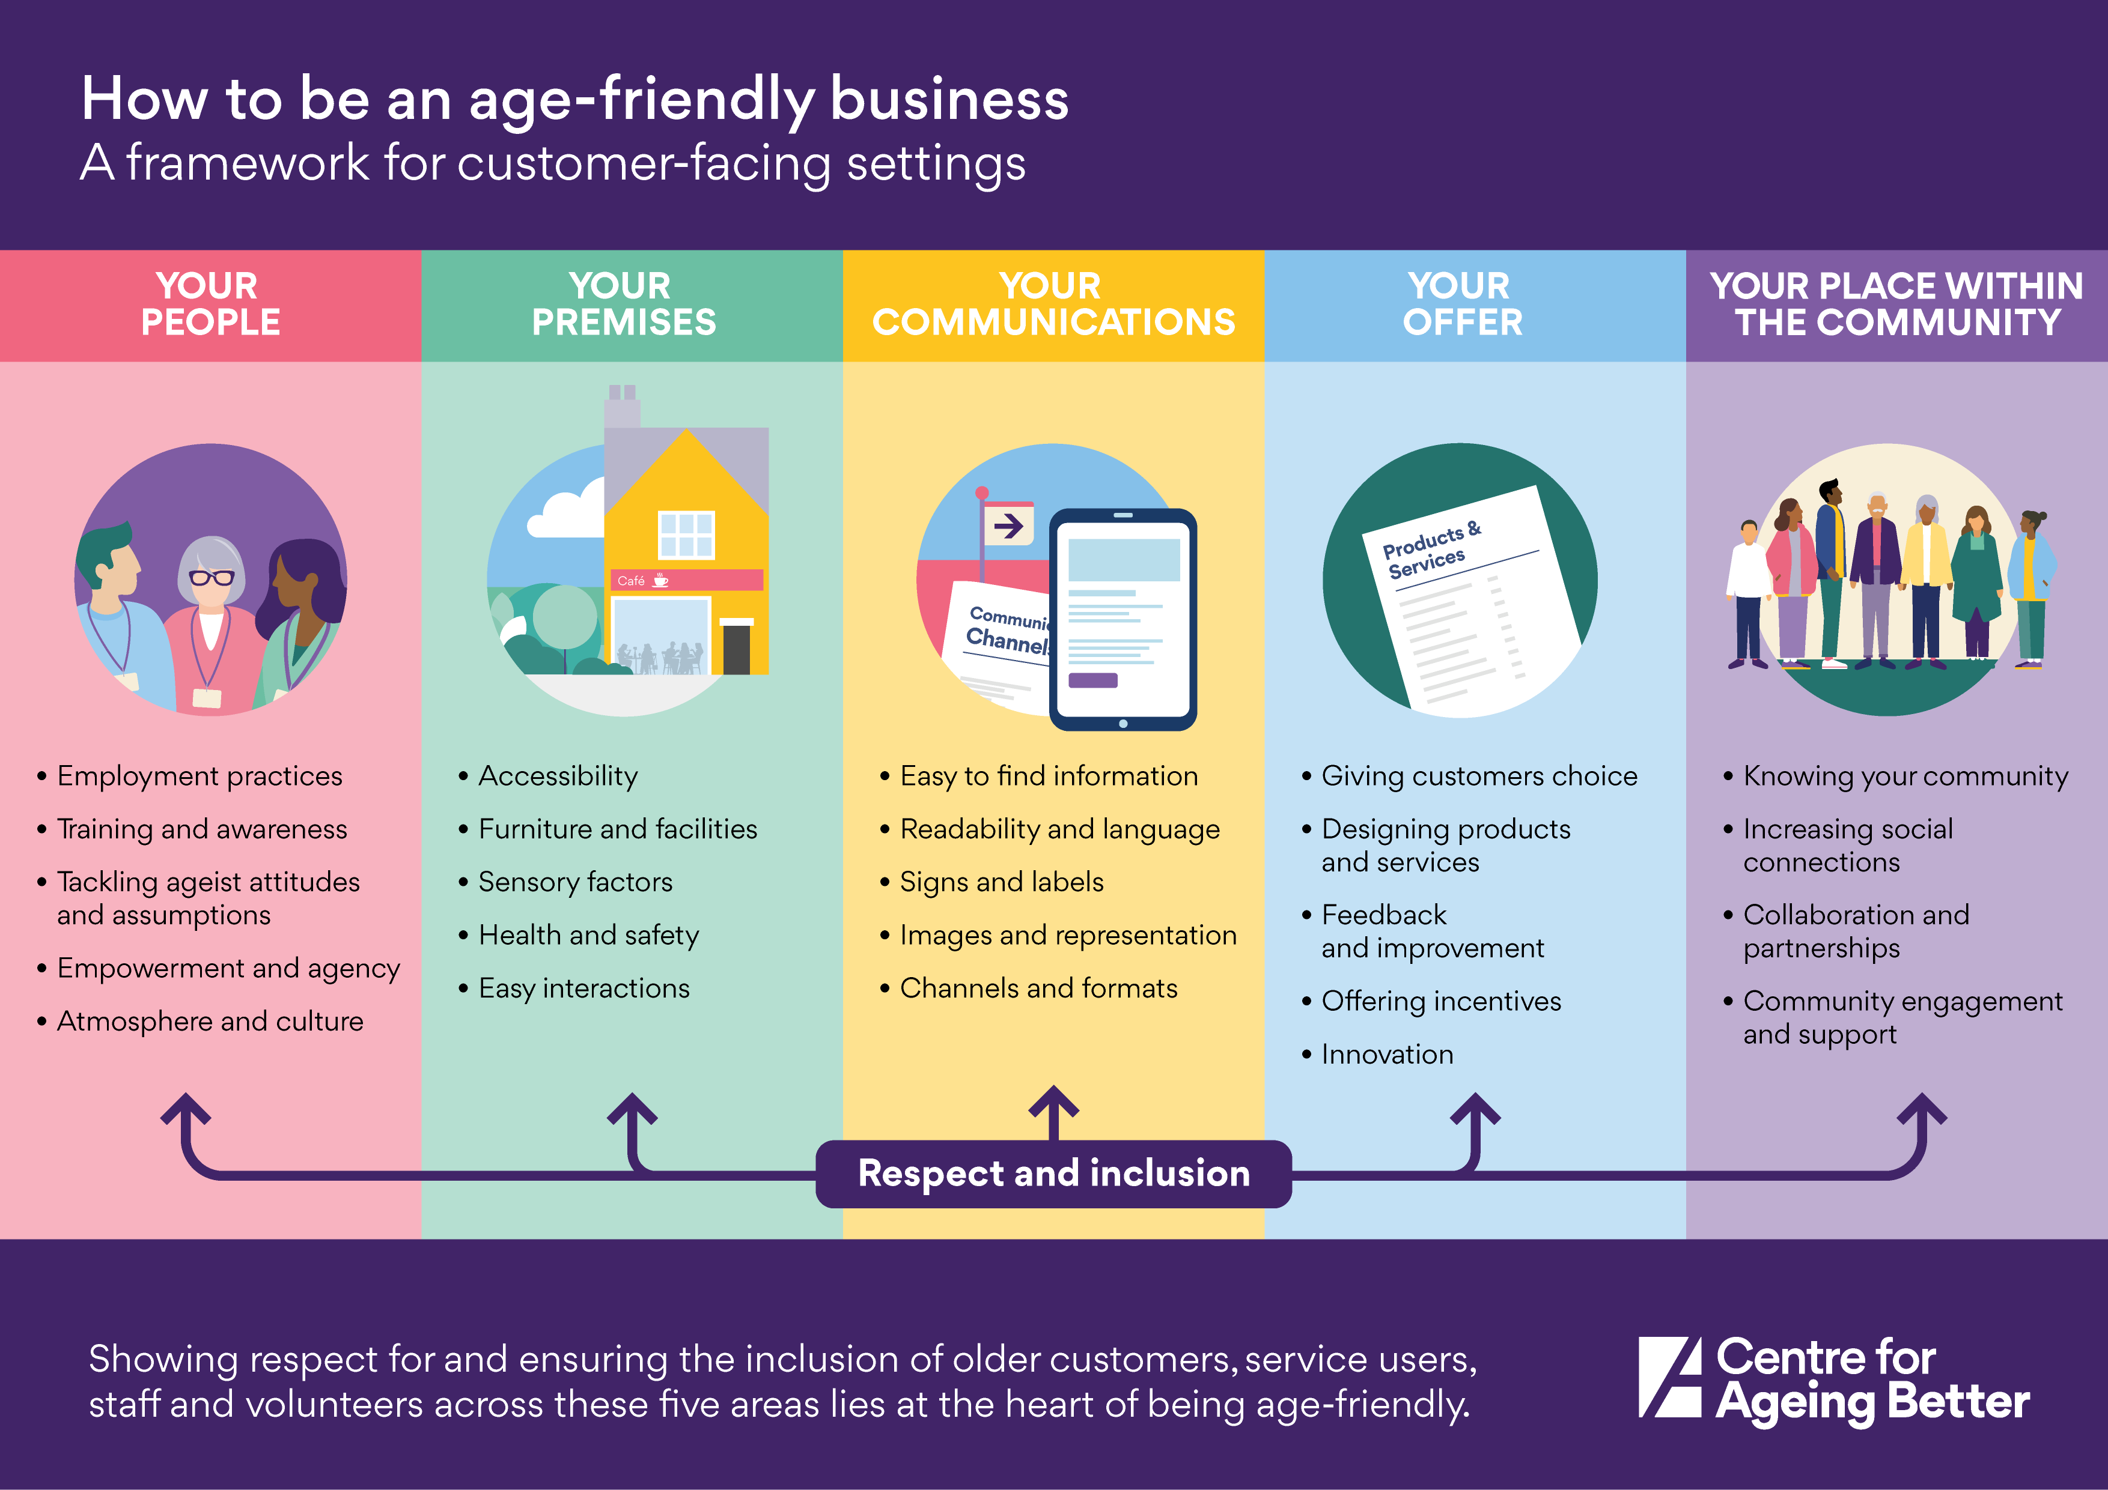
Visual representation
ageing-better.org.uk/age-friendly-businesses
Notes:
This is a visualisation of the framework. It shows the 5 key areas of the framework with a corresponding illustration and a list of the content covered by each area.
You can download the framework or a copy of this visualisation from the Centre for Ageing Better’s website (see link at the bottom of the slide) ageing-better.org.uk/age-friendly-businesses
The visualisation is included within the downloadable copy of the framework – within which you can click on each of these 5 areas to be taken through to the relevant content.
The next few slides provide some further information on the content of the framework including examples of recommendations across each of the 5 areas.

Slide 8
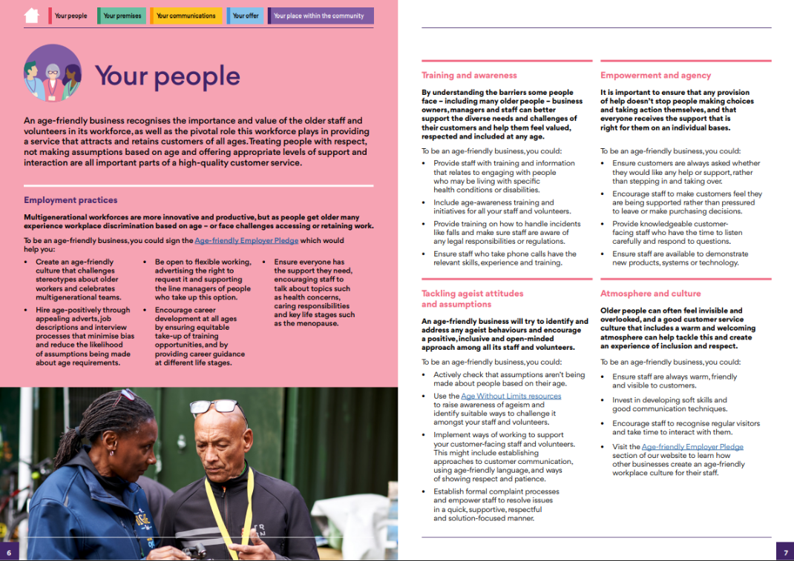
Your people
Content covers… | For example…
Employment practices | Be open to flexible working
Training and awareness | Provide staff with training about specific health conditions or disabilities
Tackling ageist attitudes and assumptions | Use the Age Without Limits resources to raise awareness
Empowerment and agency | Provide knowledgeable customer-facing staff
Atmosphere and culture | Encourage staff to recognise regular visitors
A ‘one size fits all’ approach to customer service runs the risk of either excluding the older demographic altogether or, as we have increasingly seen, patronising or dismissive interactions.
Institute of Customer Service
Notes:
The first section of the framework is about Your people. It makes the case that an age-friendly business recognises the importance and value of the older staff and volunteers in its workforce, as well as the pivotal role this workforce plays in providing a service that attracts and retains customers of all ages. Treating people with respect, not making assumptions based on age, and offering appropriate levels of support and interaction are all important parts of a high-quality customer service.
It includes:
Employment practices – For example being open to flexible working, advertising the right to request it and supporting the line managers of people who take up this option
Training and awareness - For example providing staff with training and information that relates to engaging with people living with specific health conditions or disabilities.
Tackling ageist attitudes and assumptions – For example using the Age Without Limits resources to raise awareness of ageism and identify suitable ways to challenge it amongst your staff and volunteers.
Empowerment and agency – For example providing knowledgeable customer-facing staff who have the time to listen carefully and respond to questions.
Atmosphere and culture – For example encouraging staff to recognise regular visitors and take time to interact with them.
The Institute of Customer Service identifies the risk of taking an uninformed and what might be deemed lazy approach to customer interactions.
Source: More than a million over 65s have experienced bad customer service because of their age. The Institute of Customer Service, 2020.
Available at: www.instituteofcustomerservice.com/over-65s-bad-service

Slide 9
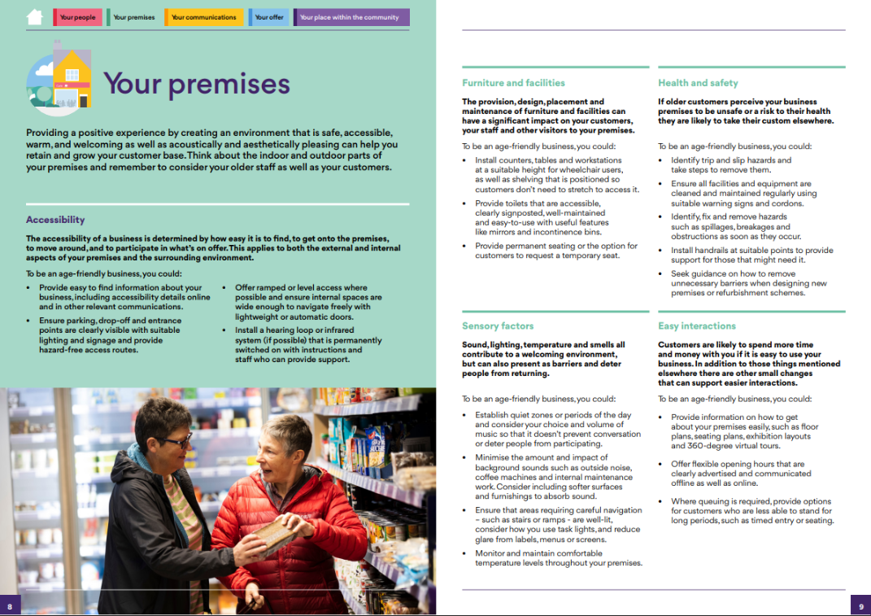
Your premises
Content covers… | For example…
Accessibility | Offer ramped or level access
Furniture and facilities | Provide seating
Sensory factors | Ensure areas requiring careful navigation are well-lit
Health and safety | Identify, fix and remove hazards as soon as they occur
Easy interactions | Provide information on how to get about the premises
Up to £3.8 billion is lost per year as a result of businesses failing to cater to over 50s with walking difficulties.
International Longevity Centre
Notes:
Your premises talks about providing a positive experience for older customers by creating an environment that is safe, accessible, warm, and welcoming as well as acoustically and aesthetically pleasing, which can help you retain and grow your customer base. Think about the indoor and outdoor parts of your premises and remember to consider your older staff as well as your customers.
This section of the framework includes:
Accessibility – For example offer ramped or level access where possible and ensure internal spaces are wide enough to navigate freely with lightweight or automatic doors.
Furniture and facilities – For example provide permanent seating or the option for customers to request a temporary seat.
Sensory factors (which covers such things as sound, lighting, temperature, smells) – For example Ensure that areas requiring careful navigation – such as stairs or ramps - are well-lit, consider how you use task lights, and reduce glare from labels, menus or screens.
Health and safety – For example Identify, fix and remove hazards such as spillages, breakages and obstructions as soon as they occur.
Easy interactions – For example Provide information on how to get about your premises easily, such as floor plans, seating plans, exhibition layouts and 360-degree virtual tours.
A report by the International Longevity Centre found that up to £3.8 billion is lost per year as a result of businesses failing to cater to over 50s with walking difficulties -demonstrating why thinking about accessibility is so important from a business perspective.
Source: The Missing £Billions: The economic cost of failing to adapt our high street to respond to demographic change. International Longevity Centre, 2016
Available at: ilcuk.org.uk/the-missing-billions-the-economic-cost-offailing-to-adapt-our-high-street-to-respond-to-demographic-change
Note: The ILC have calculated that if consumers aged over 50 with a mobility issue were to spend as much on eating out, clothing and leisure, as consumers of the same age and with the same socio-economic characteristics but without a walking difficulty, we could have an increase in annual spending between £470 million and £3.84 billion.

Slide 10
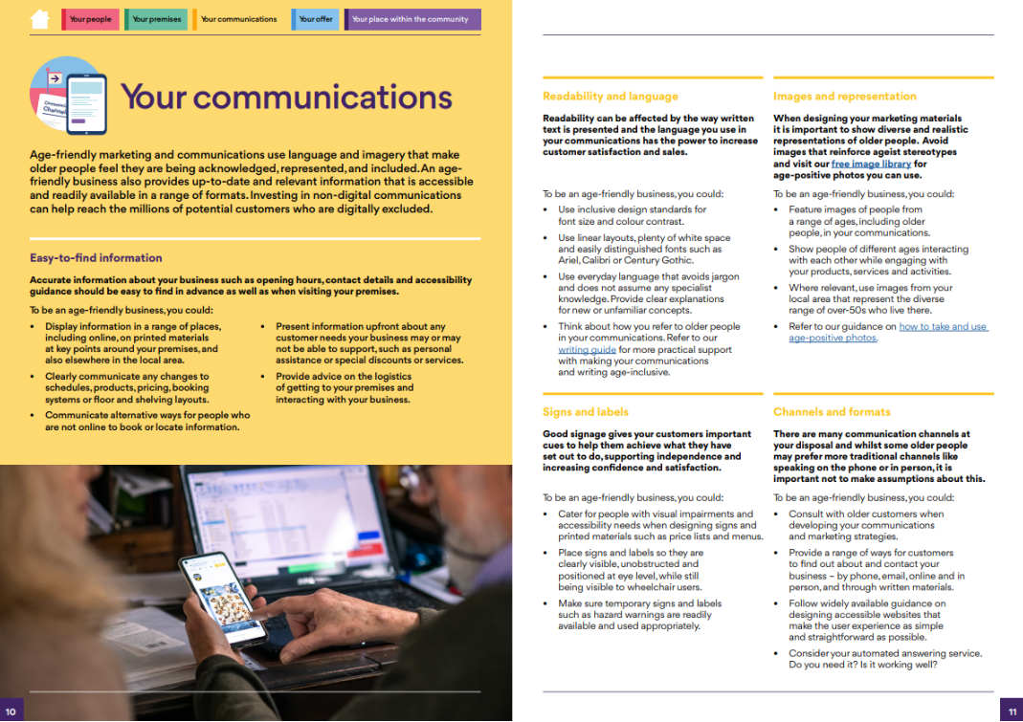
Your communications
Content covers… | For example…
Easy to find information | Display information in a range of places
Readability and language | Use everyday language that avoids jargon
Signs and labels | Place signs and labels so they are clearly visible
Images and representation | Use images of people from a range of ages
Channels and formats | Offer a range of ways to contact the business
Older people are not a single segment. This group is too complex to be stereotyped and too diverse to be second-guessed. Yet that’s exactly what some businesses are doing.
Mature Marketing Association
Notes:
Age-friendly marketing and communications use language and imagery that make older people feel they are being acknowledged, represented, and included. An age-friendly business also provides up-to-date and relevant information that is accessible and readily available in a range of formats. Investing in non-digital communications can help reach the millions of potential customers who are digitally excluded.
Your communications includes:
Easy to find information – For example display information in a range of places, including online, on printed materials at key points around your premises, and also elsewhere in the local area.
Readability and language – For example use everyday language that avoids jargon and does not assume any specialist knowledge. Provide clear explanations for new or unfamiliar concepts
Signs and labels – For example place signs and labels so they are clearly visible, unobstructed and positioned at eye level, while still being visible to wheelchair users
Images and representation – For example feature images of people from a range of ages, including older people, in your communications.
Channels and formats - For example provide a range of ways for customers to find out about and contact your business – by phone, email, online and in person, and through written materials.
Mark Beasley chairman of the Mature Marketing Association highlights how important it is for businesses not to think of older people as one homogenous group but to recognise and value the enormous diversity.
Source: Marketing to older consumers Marketing Donut Marketing Donut (date unknown). Marketing to older consumers. [online]
Available at: https://www.marketingdonut.co.uk/marketing-essentials/your-target-market/marketing-to-older-consumers

Slide 11
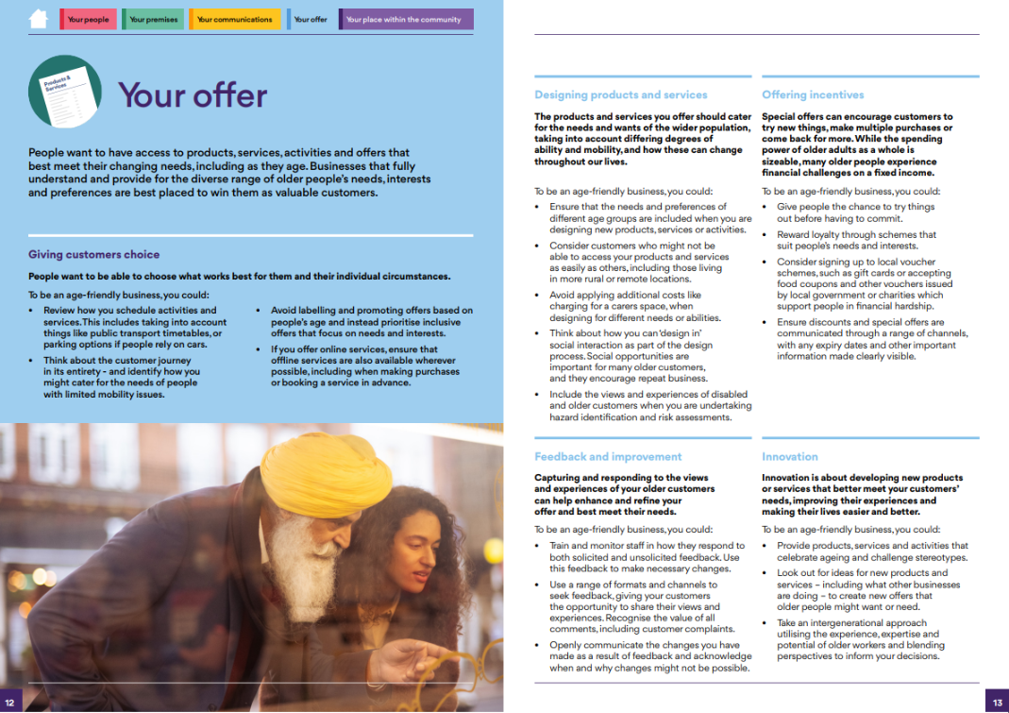
Your offer
Content covers… | For example…
Giving customers choice | Prioritise inclusive offers that focus on needs and interests
Designing products and services | Ensure that the needs and preferences of different age groups are included
Feedback and improvement | Give customers the change to share their views and experiences
Offering incentives | Give people the chance to try things out
Innovation | Take an intergenerational approach and blend perspectives
4 in 5 people aged over 55 say their favourite retail brand no longer understands them or what they need.
Centre for Ageing Better
Notes:
People want to have access to products, services, activities and offers that best meet their changing needs, including as they age. Businesses that fully understand and provide for the diverse range of older people’s needs, interests and preferences are best placed to win them as valuable customers.
Your offer covers:
Giving customers choice – For example avoid labelling and promoting offers based on people’s age and instead prioritise inclusive offers that focus on needs and interests.
Designing products and services – For example ensure that the needs and preferences of different age groups are included when you are designing new products, services or activities.
Feedback and improvement – For example use a range of formats and channels to seek feedback, giving your customers the opportunity to share their views and experiences. Recognise the value of all comments, including customer complaints
Offering incentives – For example give people the chance to try things out before having to commit
Innovation – For example take an intergenerational approach utilising the experience, expertise and potential of older workers and blending perspectives to inform your decisions.
Taken from some of Ageing Better’s previous research this quote highlights how few people over the age of 55 feel understood by their favourite retailers.
Source: The missing market: How home retailers can better meet the needs of over-50s consumers, Centre for Ageing Better, 2021
Available at: https://ageing-better.org.uk/missing-market-how-home-retailers-can-better-meetneeds-over-50s-consumers-online-version

Slide 12
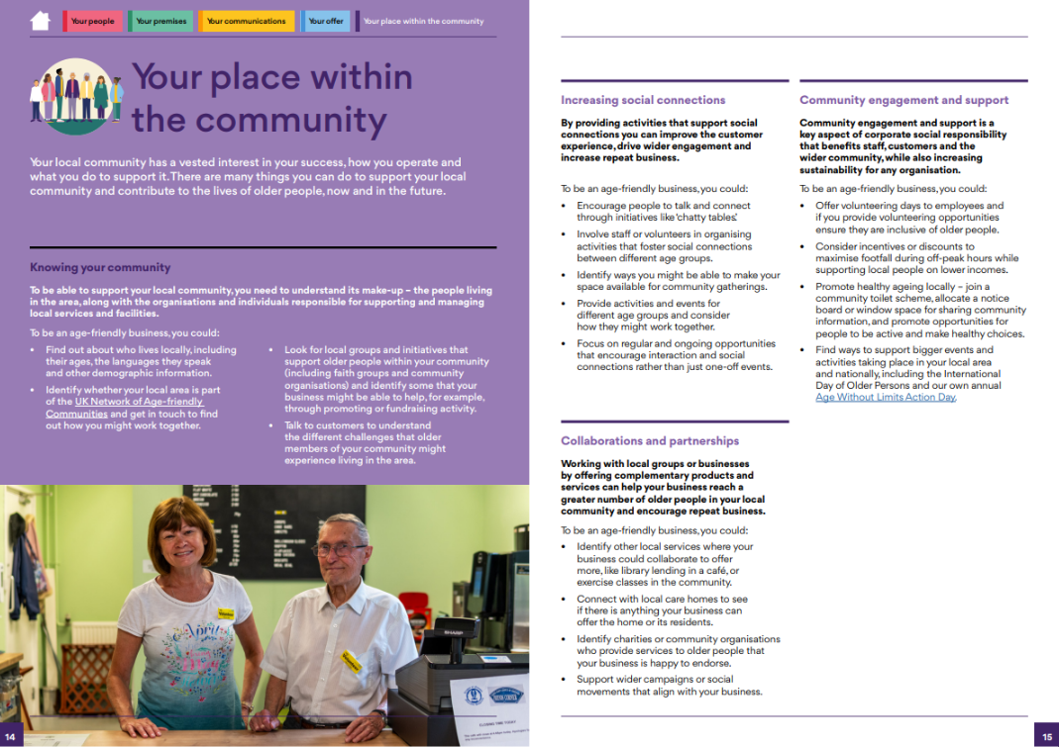
Your place within the community
Content covers… | For example…
Knowing your community | Find out about who lives locally
Increasing social connections | Encourage people to talk and connect
Collaboration and partnerships | Work with local businesses to offer more
Community engagement and support | Offer volunteering days to employees
Tackling social isolation through supporting social contact is an important task in allowing people to ‘age in place’.
Sophie Yarker
Notes:
The final section of the framework is Your place within the community, which focuses on the role that businesses play within their local community – recognising the mutual benefit that thriving businesses and communities can bring to each other. This includes the value of collaboration and supporting local residents, community groups and age-friendly initiatives and reference to corporate social responsibility.
This section of the framework covers:
Knowing your community, for example by finding out about who lives locally, including their ages, the languages they speak and other demographic information.
Increasing social connections, for example by encouraging people to talk and connect through initiatives like ‘chatty tables’.
Collaboration and partnerships, for example identifying other local services where your business could collaborate to offer more, like library lending in a café, or exercise classes in the community.
Community engagement and support. For example, you could offer volunteering days to employees and if you provide volunteering opportunities ensure they are inclusive of older people.
Research by Sophie Yarker in Greater Manchester highlights that businesses can have a really important role to play in helping to tackle social isolation and in encouraging social contact which are vital in supporting older people to remain within their communities. (*’Age in place’ is the concept of enabling people to remain living in their own homes and communities as they age).
Source: Social Infrastructure: How shared spaces make communities work, Yarker, 2019
Available at: https://www.gmcvo.org.uk/publications/social-infrastructure-how-shared-spaces-make-communities-work

Slide 13
Call to action
What can we do to make our businesses and community settings in XXX more age-friendly?
​
Notes:
EDITABLE SLIDE:
Use this slide to
Remind the audience why this is important, including referencing some of the stats used at the start of the presentation.
Then pose the question / make the call to action
Include any information about local plans and age-friendly initiatives, including bonuses for businesses that the LA / AfC or other organisations might be offering e.g., promotional activity, window stickers, newsletters, networking events.
Insert your own script for this slide.

Slide 14
It’s not about being perfect, it’s about making improvements.
Even the smallest changes can make a huge difference to how people experience your business.
Being age-friendly is good for businesses,
good for people of all ages and good for our wider society.
Download the framework from: ageing-better.org.uk/age-friendly-businesses
Email: localities@ageing-better.org.uk
Notes:
The messaging behind the framework is that it’s not about being perfect or having to invest substantial amounts of time and money – it’s about making improvements but also helping to identify what businesses might already be doing well and could do more too!
Even the smallest changes can make a huge difference!
Being age-friendly is good for businesses, good for people of all ages and good for our wider society.
You can download a copy of the framework or access other age-friendly business resources and information from the Centre for Ageing Better’s website.
If this topic is of great interest to you – you can also request a detailed version of the framework that includes more background information, quotes, useful links, resources, and an overview of how the framework was developed.
Download the framework from: ageing-better.org.uk/age-friendly-businesses
Email: localities@ageing-better.org.uk

